Slide 1
Assuring quality in the ESS
Symposium: Safeguarding trust in official statistics - launching a Code of Practice for the Irish statistical system
Thursday, 21st November 2013, Dublin
Walter J. Radermacher, Director General of Eurostat

Slide 2
Irish Statistical System ISS
15 statistical authorities
1 CSO
Xy statistical entities

Slide 3
European Statistical System ESS
Xyz statistical entities
390 statistical authorities
32 NSIs
Eurostat

Slide 4
European Statistical System ESS
Xyz statistical entities
390 statistical authorities
32 NSIs
Eurostat
"Other statistics" at national level produced or coordinated by the NSI
"Other statistics" at European level coordinated by Eurostat

Slide 5
First quality initiatives: 1999 - 2003
D
D
Leadership group on quality (LEG Q)
Management
Development – Production - Dissemination
Q
11 background papers and 22 recommendations (e.g. Q conferences)

Slide 6
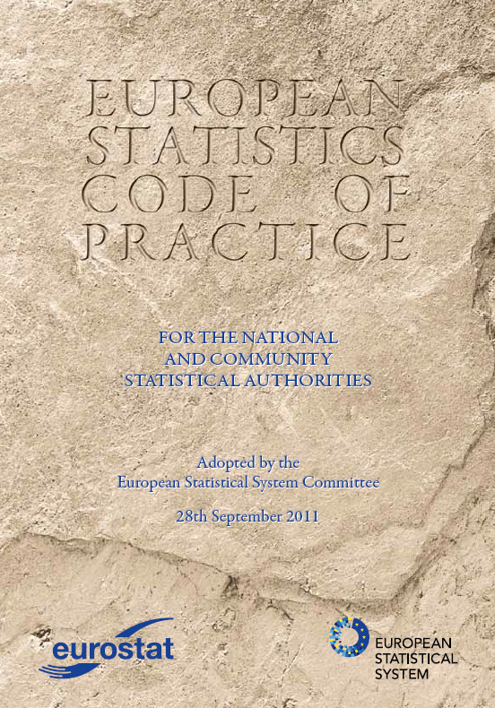
First crisis of trust 2004/2005
Approval of Code of Practice
(revised in 2011);
Creation of the ESS and the ESSC;
Governance body: ESGAB;
First regulation on EDP, with gaps;
First round of peer reviews.

Slide 7
Second crisis of trust 2009/2010 (I)
Second regulation on EDP
Communication 211/2011: "Towards robust quality management"
Sponsorship on quality. Revision of CoP and ESS QAF
Amendment of regulation 223/2009 (statistical law)
Second round of peer reviews 2014-2015

Slide 8
Second crisis of trust 2009/2010 (II)
Streamlining of ESSC: strengthen coordination
ESP 2013 – 2017
Development of ESS.VIPS and establishment of TF vision 2.0
Reinforcement of MIP
Quality and metadata reporting: SIMS
Sponsorship on standardisation

Slide 9
Thank you for your attention!
Walter.Radermacher@ec.europa.eu
http://ec.europa.eu/eurostat

